Slide 1
The Eight Critical Drivers that Increase Company Value
A Presentation By
Benchmark Business Group

Slide 2
Our Focus Today
Almost half of all privately-held businesses are owned by Baby Boomers—people older than 53
6 out of 10 plan on selling in the next ten years
In Iowa alone, there are 23,660 businesses owned by people over 50, representing sales of $57.2 billion

Slide 3
Our Focus Today
The great majority of businesses are not worth what their owners hope to get, or are completely unsaleable
The reasons are unmistakable, but owners continue to do the same thing and expect different results

Slide 4
Our Focus Today
35% of small business owners are wholly relying on selling their business to fund retirement
Over 2/3’s have no idea what their business is worth to a buyer

Slide 5
The Eight Drivers of Value
The Switzerland Structure
Financial Performance
Growth Potential
The Valuation Teeter Totter

Slide 6
The Eight Drivers of Value
Recurring Revenue
Monopoly Control
Customer Satisfaction
Hub & Spoke

Slide 7
The Switzerland Structure
The dependency your business has on three sectors: Customers, Employees, and Vendors.
The Problem:
Aging customer base
Too few customers/revenue source concentration
Employees have operating knowledge in their heads

Slide 8
The Switzerland Structure
The dependency your business has on three sectors: Customers, Employees, and Vendors.
Turnover is expensive and disruptive
No clear succession strategy for key people
Few supplier alternatives
No transferable supplier arrangements
Supplier credit is relationship dependent

Slide 9
The Switzerland Structure
The dependency your business has on three sectors: Customers, Employees, and Vendors.
The Solution:
Reduce dependence on key customers
Reduce dependence on key employees
Reduce dependence on key suppliers

Slide 10
Financial Performance
Estimates the future streams of profit that your business will have if your business continues at its current rate of growth.
The Problem:
Revenue either lackluster, flat or declining
Gross and net profit margins out-of-sync for the industry
The financial records are in disarray and not current

Slide 11
Financial Performance
Estimates the future streams of profit that your business will have if your business continues at its current rate of growth.
The Solution:
Increase your revenue
Increase your profit margins
Formalize your bookkeeping

Slide 12
Growth Potential
The likelihood that your business will continue to grow in the future.
The Problem:
Lack of a written marketing strategy and plan
Failure to understand most probable and flanker markets
Knowing market share/demographics
Stale or non-responsive product strategies

Slide 13
Growth Potential
The likelihood that your business will continue to grow in the future.
The Solution:
New products to existing customers
Add more customers
Enter new geographic markets
Enter new demographic segments

Slide 14
The Valuation Teeter Totter
How consistently cash flows through your business.
The Problem:
Involuntarily financing your customers
Receivables too high and too old
Lack of a cash management plan

Slide 15
The Valuation Teeter Totter
How consistently cash flows through your business.
The Solution:
Improve cash flow
Get paid faster
Pay bills slower

Slide 16
Recurring Revenue
The amount of automatic annuity-based revenue that you collect each month.
The Problem:
Customized products or services
Delivery and service not turn-key
Too many transactional, non-recurring services
Business seen as a commodity vs a brand

Slide 17
Recurring Revenue
The amount of automatic annuity-based revenue that you collect each month.
The Solution:
Contracts
Auto-renewal
Sunk-money subscriptions
Subscriptions
Sunk-money consumables
Consumables

Slide 18
Monopoly Control
There is a clear and distinct difference between your products/services and your competition.
The Problem:
Principal competitive strategies:
Operational excellence (competitive price)
Product superiority (product leader)
Customer intimacy (owning the customer relationship)

Slide 19
Monopoly Control
There is a clear and distinct difference between your products/services and your competition.
The Solution:
Create a better mousetrap, or
Create a marketing strategy:
1. Something that makes you different
2. Something people care about
3. Impress people with your systems

Slide 20
Customer Satisfaction
How likely it is that your customers repeat business with you and refer you to others.
The Opportunity:
Promoters vs “satisfied customers” vs detractors
The Net Promoter Score
(9’s and 10’s) minus (0’s thru 6’s) = NPS
Ignore the 7’s and 8’s

Slide 21
Customer Satisfaction
How likely it is that your customers repeat business with you and refer you to others.
The Solution:
Measure your Net Promoter Score
Focus on the verbatim response of detractors

Slide 22
Hub & Spoke
The ability of your business to thrive without you
for at least 3 months.
The Problem:
Most owners do too much of the wrong work
Too much operational knowledge lives in the owner’s head
Creating a job vs a business
Could not run for an extended period without the business owner

Slide 23
Hub & Spoke
The ability of your business to thrive without you
for at least 3 months.
The Solution:
Create systems employees can follow
Create a “Stop Doing” list
Automate as much as possible
Take a vacation…a long one

Slide 24
Assessment—Our Gift to You
You are invited to do an assessment of your business, on line, absolutely free
The total time it will take is about 15 minutes
We will also provide a free Opinion of Value for your business
Complete the contact form and give it to me at the end of this presentation

Slide 25
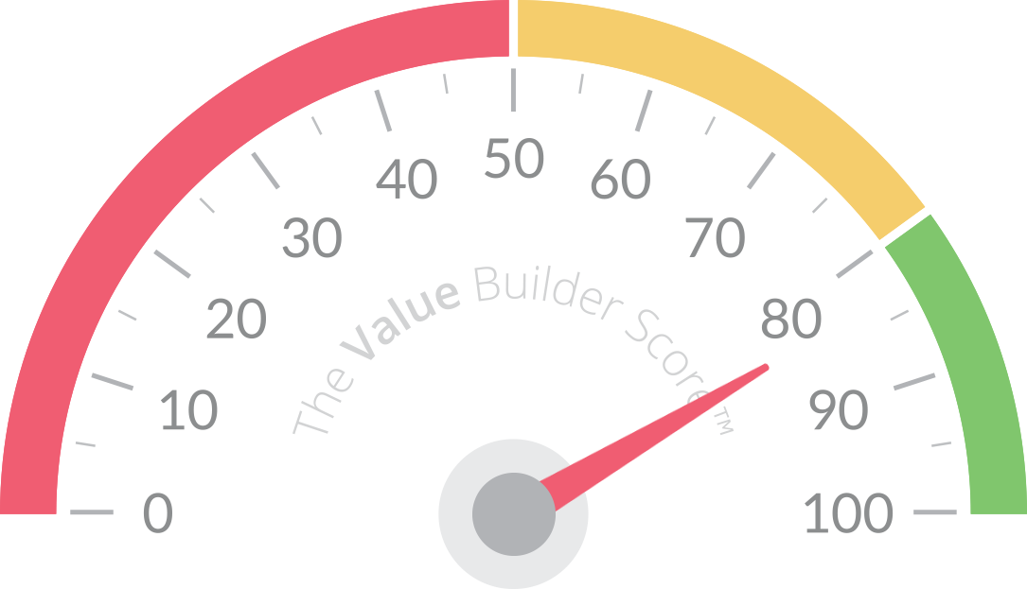
Assessment—Our Gift to You
You will also receive an hour of free consulting on your Value Builder results

Slide 26
Some Thoughts About Succession Planning and “Option” Strategies
A Presentation By
Benchmark Business Group
BenchmarkBusinessGroup.com
515-288-6984

Slide 27
The “RIGHT” Time
“The best time to plant a tree is twenty years ago; the second best time is now.” ~ancient proverbt time is now.” --ancient proverb

Slide 28
Key Considerations
Having a clear vision for your life after the business
Having a clear vision for the business
Having a clear strategy for growth of the business—products and markets
Getting your financial house in order—clean and current

Slide 29
Key Considerations
Knowing your business’ value and why
Creating turn-key systems and processes
Limiting owner dependency
Having robust personnel succession strategies—position descriptions, operating systems, training, recruiting systems

Slide 30
Exit (Option) Strategies
Third party sale
Internal sale/transfer
Shut the door
Estate sale

Slide 31
Exit (Option) Strategies
Third Party Sale—Key Considerations:
Confidentiality
Deal team
Proper valuation
Qualifying buyers
Marketing
Length of time to sell
Financing
Tax issues

Slide 32
Exit (Option) Strategies
Internal Sale/Transfer—Considerations:
Capability of buyer(s) to assume ownership
Confidentiality
Deal financing
Valuation issues
Risks to be aware of

Slide 33
Some Final Advice
Work ON your business, not just IN it
Processes and People are your most valuable assets
Invest wisely in your business
Run your business like you are going to keep it until you get the check!
Start getting it ready for sale or other transfer NOW.

Slide 34
Questions?
A Presentation By
Benchmark Business Group
BenchmarkBusinessGroup.com
515-288-6984

