Slide 1

Fall Conference
December 1, 2016
Iowa Land Title Association
February 19, 2018
IOWA LAND RECORDS
1

Slide 2
topics
    Accomplishments
    Current Metrics
    Future Plans
    Request For Support

Slide 3
Accomplishments
    Enabled Electronic Filing of Surveys and Plats
      Large Scale – Up to 36 Inches
      Landscape Format
      Scanned and Rendered Images
      Moved to Production – October, 2017
      Standards for Index Legends and Stamping Completed

Slide 4
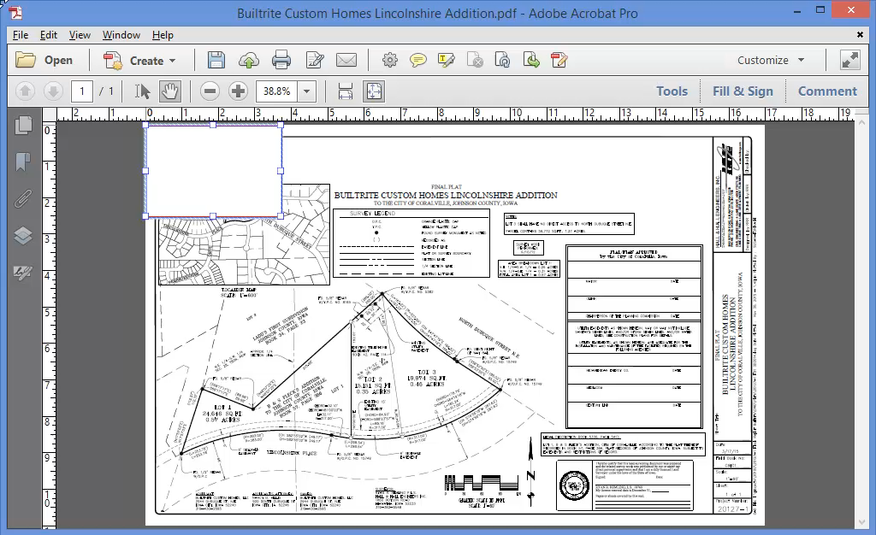
E-filing surveys and plats
Developed New Method for Recording Stamp Placement

Slide 5

Accomplishments
        Increased Security
          Iowa Department of Revenue and IRS Safeguard Review

Slide 6

ILR
Iowa Land Records (“ILR”)
  We Make It Easy for Real Estate Professionals and Citizens to Access Documents
    Free Access to more than 17.7 million recorded documents
      Over 21,000 users perform more than 2.8 million searches each year
      Average of nearly 7000 unique users per month
  ILR Serves Citizens and the Real Estate Industry
    Citizens and Property Owners
    Bankers and Credit Unions
    Mortgage Companies
    Real Estate Attorneys and Legal Assistants
    Realtors and Brokers
    Surveyors
    Land Title and Abstract Companies
    Federal, State and Local Governments

Slide 7
ILR
Searching ILR Is Useful to ALL
  During a sample month in 2017 there were:
  30,894 searches performed by registered users who self-identified as being associated with an Abstract Company
  36,077 searches performed by registered users who self-identified as being associated as either a Real Estate Attorney or Paralegal
  Assuming this sample month is representative … Annualized – this represents more than 800,000 searches a year by the groups who frequently work together to facilitate real estate transactions

Slide 8
ILR
Iowa Land Records (“ILR”)
  We Make It Easy for Real Estate Professionals to File Real Estate Documents
    Submit Documents Electronically to All 99 Counties
    Standard Completion Time – 24 hours or 1 Business Day
    Most County Processing Time – Average < 8 Hours
    37% of All Documents Now Electronically Filed – 2017
    E-Submission Volume Up Over 8% in 2017
    “Well Known” Abstract Co. Partner
      – 773 Documents In 2017

Slide 9
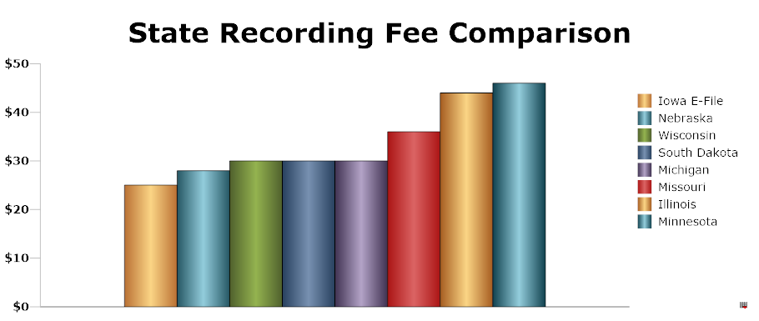
ILR
Our mission is to provide excellent and consistent services to customers and stakeholders with the most convenient and lowest cost real estate transactions in the country.
Based on recording fees for a typical four page document

Slide 10

ILR
What Are The Benefits of ILR?
  Saves Time and Money For Real Estate Professionals and Citizens
    Reducing Trips To The Courthouse
  Increases Efficiency and Productivity For County Recorders
    Using Technology To Deliver Better and Faster Service
    Extending the Reach of Services Beyond Traditional Borders

Slide 11
ILR
What Are The Benefits of ILR?
ILR and Iowa County Recorders
  Collaborate With Stakeholders to Improve and in some Cases Customize Services for Stakeholders
    Example: Society of Land Surveyors Project to Standardize Indexing of Surveys and Plats AND Enable Surveys and Plats for E-Recording
  Work to Establish Consistent Business Policies and Practices
    Example: The ESS Governing Board Adopted a Policy to Make Fees for “Additional Transactions” More Uniform

Slide 12

ILR
Cook County, Illinois – May 30, 2017:
We need look only to our neighbor, Iowa, to see what a push towards standardization would do for the people of Illinois.
“Iowa uses a highly standardized system for documenting property records, and it maintains a shared online database where county records can be easily accessed from anywhere in the state,” and as perhaps the only state that fully guarantees
citizens against title defects, its “...loss rates are the lowest in any state, as less than 2% of premiums are paid to settle claims.”
Link: http://cookrecorder.com/wp-content/uploads/2016/11/Final-Report-CCRD-Blockchain-Pilot-Program-for-web.pdf

Slide 13
Future plans
    E-Submission 2.0
      Improved Work Flow For Submitters and Recorders – Fewer “Clicks” and Actions
      Modern – “Responsive” Web Design
      Improved Mobile Device Functionality

Slide 14
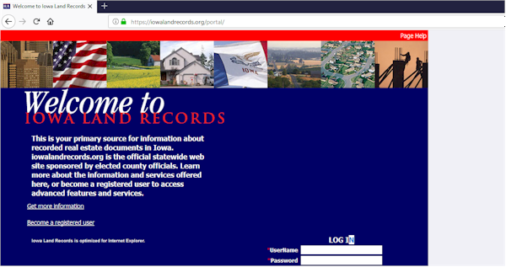
Future plans
    ILR Search Engine
      Easier Search Options and Improved Search Results
      Modern – “Responsive” Web Design
      Improved Mobile Device Functionality

Slide 15

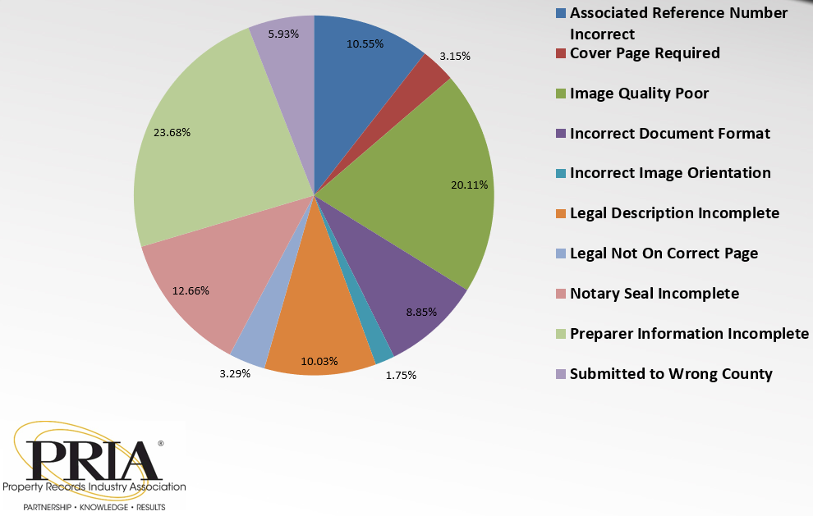
ILR
PRIA Document Rejections Workgroup
Co-Chair – Phil Dunshee
  Goals
    Reduce Rejections
    Best Practices and Standards
    Guidelines, Resources and Tools
    Better Communications
  Work Products
    Best Practices Resources
      Background Paper, White Paper, Videos, Policies
    Training, Education and Communications Plans

Slide 16
ILTA and Iowa County Recorders and ilr should be natural partners
    Shared Interest
      Accurate and Consistent Data in the Public Record
      Increased Efficiency, Speed, and Accuracy of Document Processing
      High Confidence in Real Estate Transactions and Low Loss Rates
      We Should Be Working Together

Slide 17
one thing recorders can’t change
    Iowa Recorders and ILR
      Have a Legal Mandate to Provide Free Public Access to Public Records Online
      How Can We Get Beyond That …?
        Other Key Stakeholder Groups Won’t Support Restricted Access
      We Have No Intent to Harm Iowa Title Companies
        In Our Opinion - Your Greatest Asset is the Service You Provide – Not Your Title Plants

Slide 18
Legislative proposal
    ILR Developed a Proposed Technical Amendment to Provide More Flexibility for the Use of E-Submission Service Fees
    We Haven’t Officially Received Word, but …
      We Have Anticipated ILTA Opposition for the Reasons Cited Previously
      While Other Stakeholders Were Favorable – It Clearly Wasn’t Unanimous … therefore
      No Action Expected in 2018

Slide 19
Where do we go from here?
    Ideas for Collaboration
      Increase E-Submission
      Explore Improvements in Document Work Flow
      Explore Ways to Reduce Document Rejections
      Discuss Ways to Improve Consistency in Business Policy and Practices Within Our Respective Groups and Together

Slide 20
closing
THANK YOU!
QUESTIONS?

