Slide 1
THE PATH FORWARD
ALTA’s Strategic Priorities to Advance the Industry
Iowa Land Title Association
May 6-8, 2018 West Des Moines, Iowa

Slide 2
Today’s Speaker
JACK RATTIKIN III
ALTA Board of Governors
President & CEO
Rattikin Title Company
Fort Worth, Texas
Jrattikin3@Rattikintitle.com

Slide 3
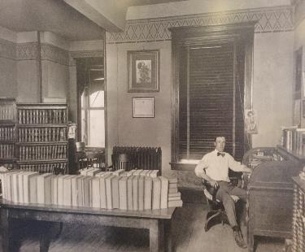
Our Company Founder

Slide 4
“The future is already here, it’s just not very evenly distributed.”
- William Gibson

Slide 5
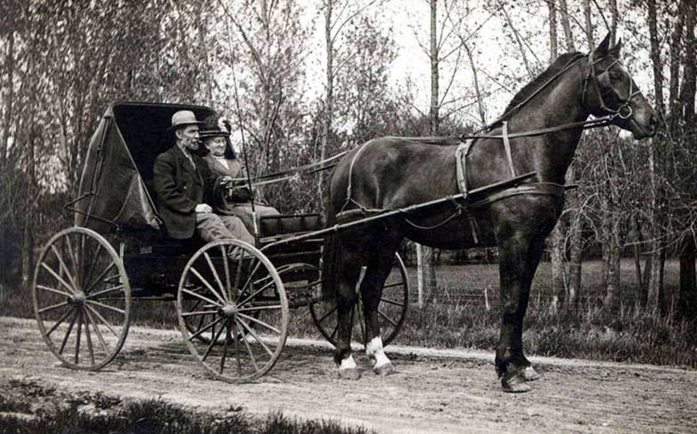

Slide 6
ALTA Strategic Priorities
Our Values
Forum for Innovation
Information Security
Customer Experience (Consumer Focused)
Talent Focus & Business Basics
Best Practices & ALTA Registry

Slide 7
1. Our Values

Slide 9
Tips for Leaders

Slide 11
2. Forum for innovation

Slide 12
New Market Entrants
Taxi Industry/Uber

Slide 13
Innovative Culture
Act on Good Ideas
Improved Website
User Experience

Slide 14
3. Information Security

Slide 15
www.altaprints.com
Member benefit
Brand with company information and logo

Slide 17
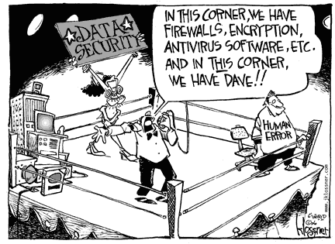

Slide 18
How can I protect my business?
Accept that a breach/fraud will happen
Conduct a risk assessment
Take reasonable preventive measures
Provide training and tips to all staff on an ongoing basis
Develop and practice your response plan
Stay abreast of the latest trends
SUBMIT ALL PHISHING EMAILS AND FRAUD ATTEMPTS TO THE FBI
IC3.gov

Slide 19
WHAT IS PHISHING/ WIRE FRAUD?
Social Engineering
Email
Website Forms
Links
Phone Calls
REPORT ALL PHISHING EMAILS AND FRAUD ATTEMPTS TO THE FBI at IC3.GOV

Slide 20
WHY YOU SHOULD CARE?
$5.3B

Slide 21
Recent Examples:
Maryland, August 2017: The FBI says fraudsters used fake emails steal the proceeds of the sale of a couple’s home. Amount lost: $411,548
New York, June 2017: A judge trying to sell her apartment received an email she thought was from her real estate lawyer telling her to wire money to an account. Amount lost: $1 million
Washington, D.C., May 2017: Homebuyers lost $1.57 million

Slide 22
Recent Examples:
Colorado, March 2017: A couple, who lost their life savings while trying to buy their dream retirement home, has filed suit alleging that none of the companies involved in the transaction did enough to protect sensitive financial information. Amount lost: $272,000
Minneapolis, September 2016: A retired couple hoping to buy a townhouse to be closer to their grandchildren, responded to a fake email and sent $205,000 to a fraudulent account. Amount lost: $205,000

Slide 23
Data Security Laws & Regulation
Insurance Data Security Model Law
National Association of Insurance Commissioners (NAIC)
Rules for insurers & agents
Risk assessment
Oversee third-party service providers
Investigate data breaches
Notify regulators
Congress debating national data security law
Bigger than Dodd-Frank Act

Slide 24
Tips To Help Prevent Wire Fraud
Call, don’t email: Confirm all wiring instructions by phone before transferring funds. Use the phone number from the title company’s website or a business card.
Be suspicious: It’s not common for title companies to change wiring instructions and payment info.
Confirm it all: Ask your bank to confirm not only the account number, but also the name on the account before sending a wire.
Verify immediately: You should call the title company or real estate agent to validate that the funds were received. Detecting that you sent the money to the wrong account within 24 hours gives you the best chance of recovering your money.

Slide 25
Tips To Help Prevent Wire Fraud
Forward, don’t reply: When responding to an email, hit “forward” instead of “reply” and then start typing in the person’s email address. Criminals use email address that are very similar to the real one for a company. By typing in email addresses, you will make it easier to discover if a fraudster is after you.
Verify wire instructions: Purchasers and Lenders should verify title company wire instructions before sending funds.
Educate real estate professionals and consumers.

Slide 26
Procedures Following Discovery of Wire Theft
Victim must contact Sending Bank and request RECALL to Receiving Bank because of Fraud.
[Title Company may also Contact their Bank Treasury contacts]
Enter Fraud Details in www.iC3.gov
Note BEC (Business Email Compromise)
Copy & Paste fraudulent email headers into Report (Not Forward)
Print Out Report for Records
Call FBI Field Office and provide Info entered into www.iC3.gov
Call Sending Bank again to ensure Recall happened
Hire Attorney in Foreign Country to Recover Funds

Slide 27
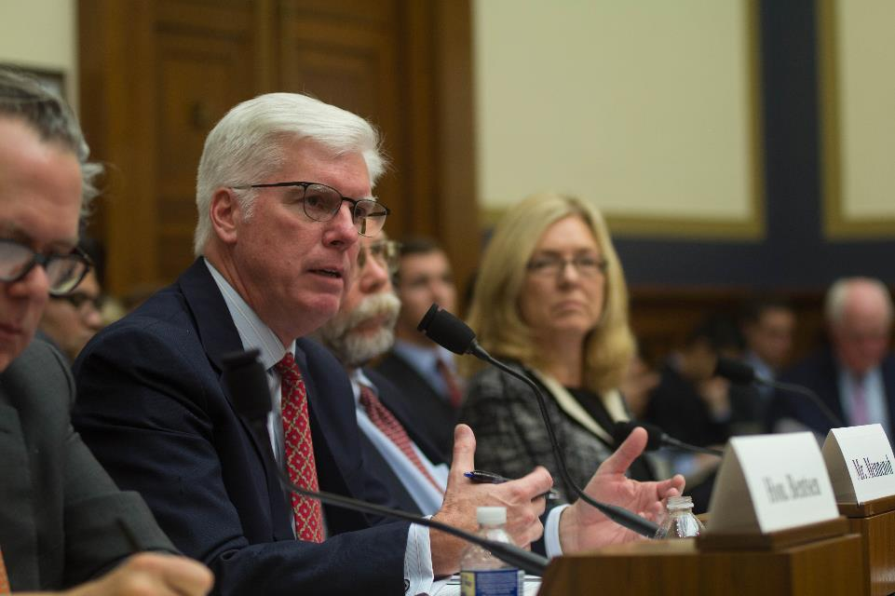
Congressional Testimony

Slide 28
Dan Mennenoh, ALTA Past President
During his testimony, Dan suggested two areas of focus to help thwart the crimes:
All parties involved in the real estate transaction—including real estate agents, banks, policy makers, consumer groups, title insurers, settlement agents and real estate attorneys—need to help educate customers of the dangers and how to protect their data and money;
Financial institutions should match not only the account number but also the payee’s name when there is a wire transfer.

Slide 29
4. Customer experience (consumer focused)

Slide 30
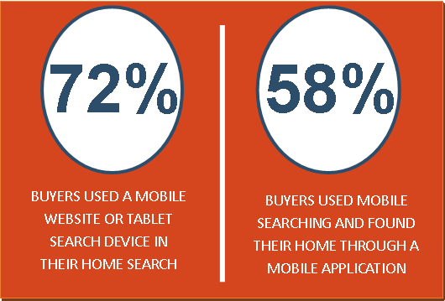
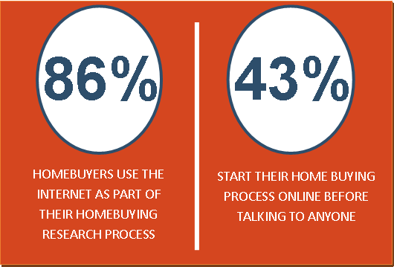
Source: National Association of Realtors

Slide 31
The Closing Table
The Kitchen Table

Slide 33
33

Slide 35
Homebuyer Guide Resources More than 60 useful tools!
Blogs
Marketing One-Pagers
PowerPoint Presentations
Rack Cards
www.alta.org/homebuyer

Slide 36
What’s
NEW

Slide 37
www.alta.org/alta-prints/

Slide 38
www.alta.org/alta-prints/

Slide 39
www.alta.org/alta-prints/

Slide 40
www.alta.org/alta-prints/

Slide 41
www.alta.org/alta-prints/

Slide 43
5. Talent Focus & Business Basics

Slide 44
The Silver Tsunami

Slide 45
What Happens Now? In case you were wondering what a Millennial looks like…

Slide 46
Assess Your True Need
Do a SWOT analysis of the current team; openly consider strengths, weaknesses, opportunities and threats.
Maybe you need to find a sales representative who can enhance your presence on social media, or you need that operations manager who can manage work flow, processes, closing calendars and put out fires.
Once you know the true need of your company, you are ready for the next step.

Slide 47
Build Your Job Profile
A clear and detailed job description is vital.
Clarify their job by defining the role after you have considered the strengths and gaps of your current team and know exactly what (and who) you need.
Define what exactly this person will need to take responsibility for on a daily basis and how it will be measured.

Slide 48
Managers account for as much as 70% of variance in Employee Engagement
30% of employees strongly agree that their manager involves them in goal setting
27% strongly agree the feedback they receive helps them do their work better
22% strongly agree their performance is managed in a way that motivates them
19% strongly agree that they talked to their manager about steps to reach their goals

Slide 49
Cast, Conduct and Choose
A great place to start looking is through your team members:
Ask them if they know of any capable individuals
Consider own personal circles
Cast a net on social media (LinkedIn, Twitter, Facebook, blog and company website)
Consider looking outside industry for younger talent
Rank candidates as they come in
Conduct interviews
Compose list of questions that will help you assess whether prospect has needed skills
Develop scoring system to evaluate each candidate fairly
Stick to scoring system

Slide 50
6. Best Practices & ALTA Registry

Slide 52
Visit the portal at www.alta.org/best-practices/faq.cfm

Slide 53
Resources
Elite Provider Program
Help title and settlement companies implement the Best Practices
Comprised of service providers committed to offering comprehensive benefits to the title insurance and settlement services industry
Elite Providers provide effective solutions for ALTA members’ critical needs
Discounts offered to ALTA members
www.alta.org/elite

Slide 54
Accurate. Efficient. Like a Jedi.

Slide 55
ALTA Registry
The national ALTA Title & Settlement Agent Registry (ALTA Registry) is a searchable online database of underwriter-confirmed title agent companies, real estate attorneys, and underwriter direct offices.
Lenders and their vendors, title agents, underwriters, and other participants in the closing process must be able to identify each other and communicate in a timely and consistent manner throughout the mortgage transaction.

Slide 56
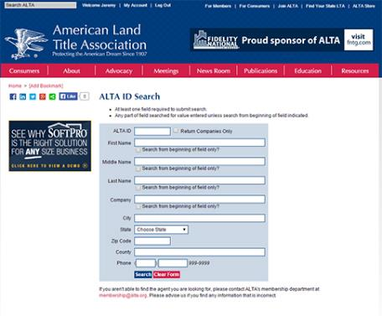
ALTA Registry
Facts
Unique ID# - Agent and Location
Phone book for lenders and others
Confidence regarding agent (Rattikin Title/Washington Title)
Not a Verification System
Cost - Free
www.alta.org/registry

Slide 57
www.alta.org/registry

Slide 58
Update from Washington, D.c.

Slide 59
Sweeping Tax Reform
We need Congress to make the CFPB work better.
A consumer regulator should:
encourage balance, stability and certainty
give clear guidance
welcome internal debate and deliberation
CFPB should be a bipartisan 5-member commission subject to Congressional appropriations

Slide 60
Tax Reform Changes
Tax Rate Reductions
Mortgage Interest Deductions
Deduction for State and Local Taxes
Standard Deduction
Alternative Minimum Tax
Like-Kind Exchanges
Carried Interest
Pass-Through Relief – IRS Decision in June
Affordable Care Act

Slide 61
CFPB
‘Less Regulation by Enforcement’
Acting Director Mick Mulvaney memo
Expect more formal rulemaking
Bureau seeks comments on investigation process
Clear Guidance
GUIDE Compliance Act would regulate the process of providing rules and guidance

Slide 62
GSE Reform
Congress has yet to enact comprehensive legislation to restructure our nation’s housing finance system
Fannie Mae and Freddie Mac were put into conservatorship in September 2008 and received a taxpayer bailout of $187 billion.
Housing finance reforms should encompass:
Title insurance requirement
Preserve the 30-year-fixed-rate pre-payable mortgage
Allow small businesses to compete in the mortgage market
Equal access to credit in urban, suburban and rural communities

Slide 63
State Activity

Slide 64
Predictable Recording Fees are a WIN for:

Slide 65
Remote Online Notary (RON)
State laws in Indiana, Virginia, Montana, Nevada and Texas now allow for the use of RON in real estate transactions.
During 2018, Secretaries of State in Nevada and Texas will release regulations for the use of RON.
Resources: alta.org/RON
MBA-ALTA Model Bill
Safe for Consumers
Insurable
Technology Neutral
Successful Legislation
Disclosure on face of document
Strong Authentication Standards
Record Retention
Appropriate Rules and Regulations to come
Title Agents will need Software from vendors

Slide 66
Iowa Land Title Association All-Stars
Tara B. Lawrence
Michael Moss
Cisco Gonzalez
Devon Irby
Matt Veldey

Slide 67
2018 ALTA Meetings
Homebuyer Outreach Program Leader Trainings
Minneapolis: June 18
ALTA Innovation Boot Camps
Minneapolis: June 19 - 20
ALTA Advocacy Summit
May 21 – 23 | The Watergate Hotel | Washington, DC
ALTA ONE
October 9 - 12 | JW Marriott at LA Live | Los Angeles, CA
www.alta.org/events

Slide 68
Monday Morning Checklist
Our Values
Forum for Innovation
Information Security (including wire transfer fraud)
Customer Experience (consumer-focused customer experience)
Talent Focus & Business Basics
Best Practices

Slide 69
Thank you

