Slide 1
www.iowarealtors.com

Slide 2
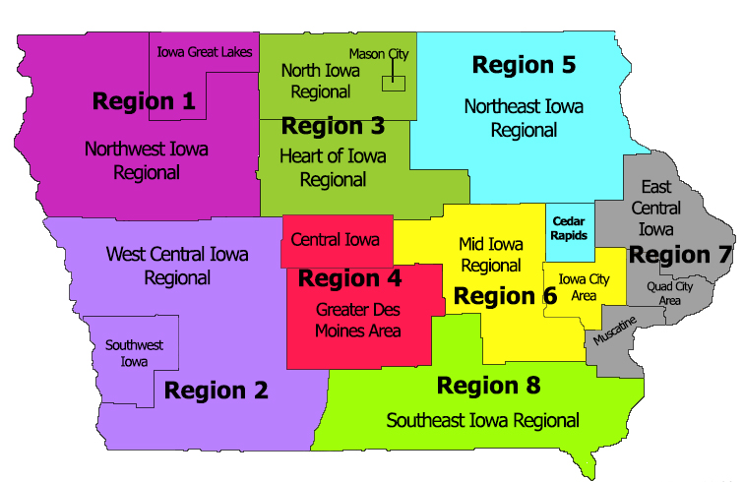
IowaRealtors.com
7,200 Realtors
17 Local Boards

Slide 3
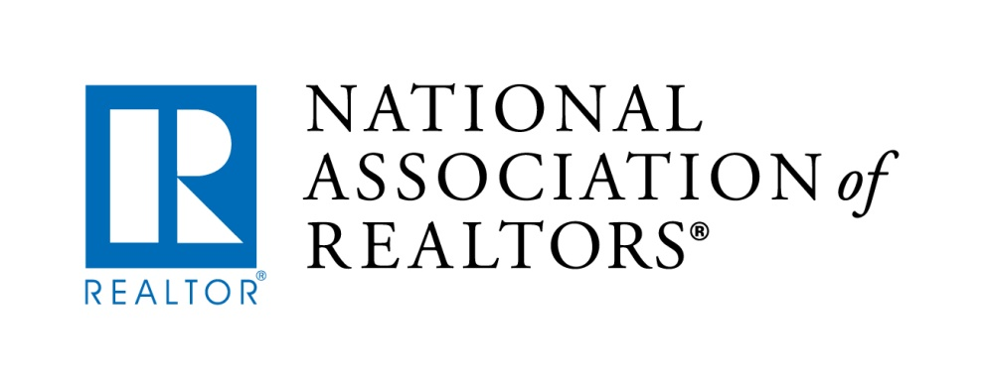
National Association of REALTORS® is nation’s largest trade association.
Over 1 Million Members involved in all aspects of residential & commercial real estate industries.

Slide 4
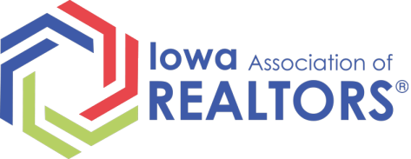
3 Way Relationship
National
State
Local/
Regional

Slide 5
The REALTOR® Difference
Not All Real Estate professionals are REALTORS®
REALTORS® pledge to a strict Code of Ethics and Standards of Practice

Slide 6
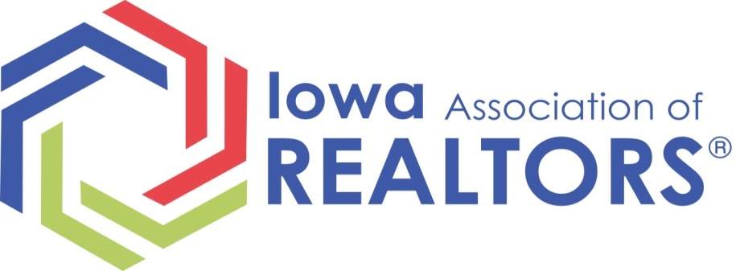
Staff of 13
Government Affairs Team
Professional Development – largest school of real estate in Iowa
Legal Hotline
Communications, Events, Marketing

Slide 7
Volunteer Leadership Structure
5 REALTORS on Leadership Team
8 REALTORS - Regional Vice Presidents

Slide 8
National Housing Stats
Existing-home sales were up 1.1 percent
2017 was best year for sales in 11 years
5.51 million sales - the highest since 2006
Source: National Association of REALTORS Research Division

Slide 9
National Housing Stats
First-Time Buyers: 32% of all buyers in 2017
Home Prices continue to Increase under Tight Supply
Source: National Association of REALTORS Research Division

Slide 10
Iowa Housing Stats
The Source for Residential Statistics
Monthly Statistics for the State
Current Housing Statistics Program will be have a major upgrade in Spring/Early Summer
More Detail by County, Realtor Board and Congressional District

Slide 11
2017 Iowa Snapshot

Slide 12
2017 Iowa Housing Stats
Median Sale Price $153,000
Record number of homes sold in 1 year
14 of 17 Boards – More Solds in 2017 than 2016
Inventory was very tight in many of major metro areas

Slide 13
2017 New Construction
National
Total Single-family building permits
817,300 up 10% from 2016
Iowa
Single-family permits 8,743 up 6% from 2016
Source – Home Builders Association of Iowa

Slide 14
Impact of Real Estate
Every Home purchase puts $50,000 into the economy over time
For every 2 homes sold, one job is created.
Source: National Association of REALTORS Research Division

Slide 15
Projections for 2018
Iowa Home Prices are expected to rise
about 3.0%
Current Market Conditions
Interest Rate Effect
Employment and Construction Momentum
Notes:
Considering the tax impact , current market conditions, interest rate effect, and the employment and construc
https://www.nar.realtor/sites/default/files/documents/2018-iowa-home-price-forecast-01-09-2018.pdf

Slide 16
National Issues
National Flood Insurance Program
Recently part of the budget extension until March 23
Tax Reform
NAR’s Government Affairs staff helped protect important pieces that benefit homeowners and real estate
Notes:
On February 9, 2018, Congress extended the National Flood Insurance Program (NFIP) as part of a broader budget agreement, which set the total amount that lawmakers can spend on an omnibus government-funding package. NAR is urging the Senate to use the next several weeks to work on a longer-term reauthorization and reform measure similar to the version passed by the House last year.
Source and more info: https://www.nar.realtor/nar-wins-pro-real-estate-provisions-in-budget-deal
MARK – you don’t need to talk about all of these, but in case they have any questions here are the included items as reported by NAR
Tax Extenders
Retroactively extends for the 2017 tax year:
Mortgage Debt Forgiveness This provision will prevent homeowners who were forced to sell their home through a short-sale last year, or who faced a foreclosure, from being taxed on the “phantom income” they received when a lender cancelled their debt.
Deduction for Mortgage Insurance Premiums This provision will allow approximately four million homeowners to deduct the mortgage insurance premiums they paid as part of their mortgage. NAR estimates that roughly two million homebuyers annually purchase a home that is subject to mortgage insurance. This provision helps make homeownership more affordable for first time and entry-level homeowners.
Energy efficient commercial buildings deduction This provision extends the deduction for the cost, up to $1.80 per square foot, of energy-efficient commercial building property. Increasing the energy efficiency of commercial buildings not only helps the environment, it saves building owners and tenants money that they can use to grow their businesses and the economy.
In addition to these three major tax extensions, there are also several more minor extenders that affect real estate, as follows:
Nonbusiness Energy Property Credit: 10 percent of amounts paid for qualified energy efficiency improvements (e.g., energy-saving roofs, windows, skylights, and doors) and 100 percent of amounts paid for qualified energy property (e.g., high-efficiency water heaters, air conditioning units, and furnaces), with respect to the taxpayer’s principal residence;
Residential Energy Efficiency Property Credit: extends and phases down the temporary components of the section 25D residential energy property credit for fuel cells, distributed wind property, and geothermal heat pumps;
Credit for energy-efficient new homes: extends the $1,000-$2,000 credit for construction and sale of qualified new energy-efficient homes.
All tax provision extensions are only for 2017.

Slide 17
Point of Sale – Local Mandates
Prohibits cities and counties from passing ordinances and other measures that would mandate inspections or fees at time of transfer/when selling or refinancing a home.
Cities and counties may still adopt ordinances requiring homeowners to have certain updates but cannot hinge on transfer of the property
Notes:
Prohibits cities and counties from passing
ordinances and other measures that would
mandate inspections or fees at time of
transfer/when selling or refinancing a home.
• Cities and counties may still adopt ordinances
requiring homeowners to have certain
updates or inspections done, but it cannot
hinge on transfer of the property.
• If an ordinance is needed to protect the safety,
health, or water quality of a community it
should not wait until the time of transfer or
sale of a home.
• These ordinances increase the cost of selling a
home and can also cause delays to the sale of
a home.
• Examples of some ordinance mandates are
sump pump, water hook up, and electric
meter inspections, energy efficiency audits
and requirements, and a variety of other
inspections and fees.

Slide 18
Point of Sale – Local Mandates
• If an ordinance is needed to protect the safety, health, or water quality of a community it should not wait until the time of transfer or sale of a home.
Did you know on average only about 5% of all homes in Iowa are sold in 1 year?
Source: REALTOR Property Resource, Census Data
Notes:
Prohibits cities and counties from passing
ordinances and other measures that would
mandate inspections or fees at time of
transfer/when selling or refinancing a home.
• Cities and counties may still adopt ordinances
requiring homeowners to have certain
updates or inspections done, but it cannot
hinge on transfer of the property.
• If an ordinance is needed to protect the safety,
health, or water quality of a community it
should not wait until the time of transfer or
sale of a home.
• These ordinances increase the cost of selling a
home and can also cause delays to the sale of
a home.
• Examples of some ordinance mandates are
sump pump, water hook up, and electric
meter inspections, energy efficiency audits
and requirements, and a variety of other
inspections and fees.

Slide 19
Point of Sale – Local Mandates
These ordinances increase the cost of selling a home and can cause delays.
Examples: Sump pump, water hook up, and electric meter inspections, energy efficiency audits and requirements, and a variety of other inspections and fees.
Notes:
Prohibits cities and counties from passing
ordinances and other measures that would
mandate inspections or fees at time of
transfer/when selling or refinancing a home.
• Cities and counties may still adopt ordinances
requiring homeowners to have certain
updates or inspections done, but it cannot
hinge on transfer of the property.
• If an ordinance is needed to protect the safety,
health, or water quality of a community it
should not wait until the time of transfer or
sale of a home.
• These ordinances increase the cost of selling a
home and can also cause delays to the sale of
a home.
• Examples of some ordinance mandates are
sump pump, water hook up, and electric
meter inspections, energy efficiency audits
and requirements, and a variety of other
inspections and fees.

Slide 20
Fair Housing – 50 years
www.FairHousing.realtor

Slide 21
REALTORS Making an Impact
Oskaloosa
Renovated Alley
Notes:
The Southeast Iowa Board of REALTORS® secured a Placemaking grant for a complete renovation of an empty alley way in Oskaloosa. The $5,000 grant assisted in alley way clean up and renovation. It is now used as an appealing community space, filled with local art, entertainment and special events. The project was even recognized as “Signature Project of the Year” by Governor Terry Branstad.

Slide 22
REALTORS Making an Impact
Ottumwa
Notes:
The Southeast Iowa Board of Realtors recently received a Smart Growth grant from NAR worth $15,000 to become a proud stakeholder in the Ottumwa Better Block project. Better Block works with communities and their leaders to create positive change by encouraging residents to take action in their community, incorporate ideas for permanent improvements, guide small businesses and entrepreneurs to open storefronts downtown, improve entertainment and quality of life for Ottumwa residents, and attract new visitors.
In October, volunteers transformed downtown Ottumwa by painting bike paths, planting trees and flowers, opening pop-up shops, and building areas for entertainment which included live music, local art, and playgrounds for children. This one day block party was a huge success, and gave Ottumwa residents and leaders the tools to continue to revitalize their downtown area and foster its growth.
This project was recognized by the National Association of Realtors® and shared through the Realtor® Action Center database which is seen by over 1.2 million Realtors®. Proud partners of this project include the: National Endowment for the Arts, National Association of Realtors®, South East Iowa Regional Board of Realtors®, Ottumwa Regional Legacy Foundation, City of Ottumwa and the University of Iowa Business Leadership Network, Main Street Ottumwa, Better Block Foundation, Iowa Economic Development Authority, and the Area 15 Regional Planning Commission.

Slide 23
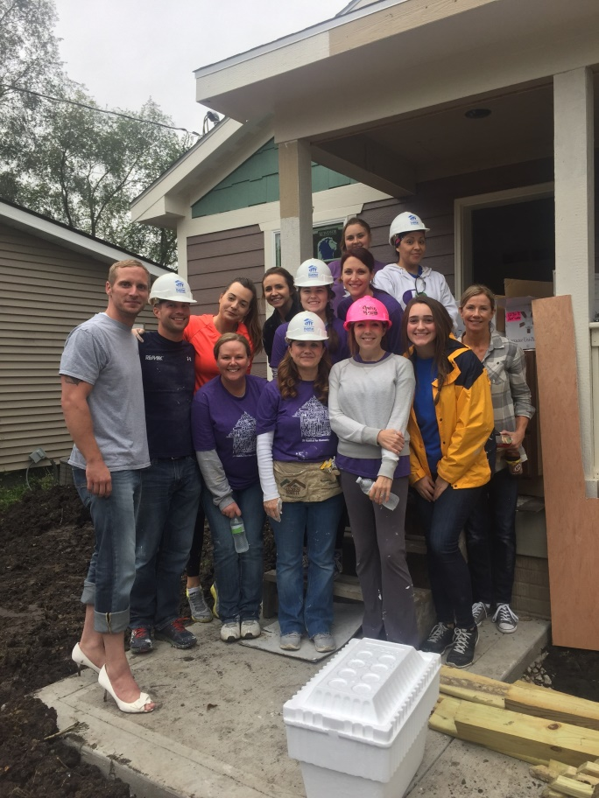
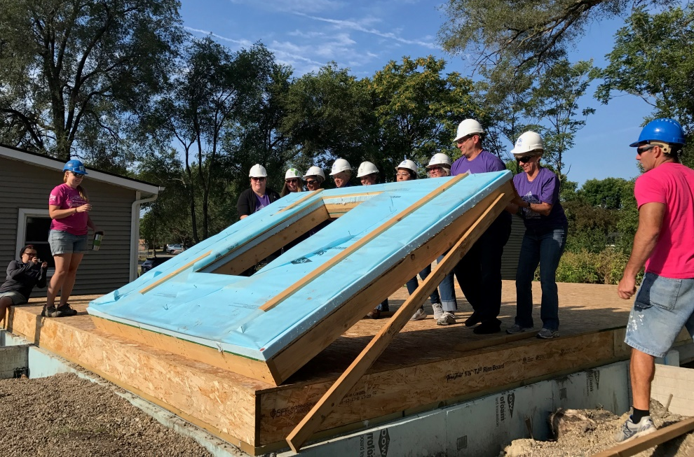
REALTORS Making an Impact
Des Moines – Hammer & Heels Habitat Project
Notes:
Mark Kamps, see description below. You can summarize. It would be good to mention it helped a veteran and her 3 boys.
DMAAR members have helped with The Habitat for Humanity
Hammer and Heels project which will benefit a single mom with three boys. "It is an honor to help out such
deserving and hardworking families in the area," said Linda Westergaard. Rebuilding Together was another
project our Realtor® members helped out with recently. "Working on Vicki Campbell's house with Rebuilding
Together, was a great experience for everyone involved and it allowed Realtors to contribute to the
community that they love," stated Linda Westergaard. Vicki is a Navy Veteran helping to raise her
grandchildren and needed some help cleaning up around the yard and making minor fixes around the house.
Des Moines area Realtors® love making a difference in their communities.

Slide 24
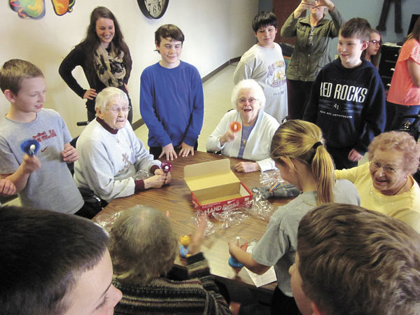
Project Jack
Pay-It-Forward Grant
Inspired by Jack Lindaman
Notes:
Originating in the Quad Cities area in memory of Jack Lindaman, the project gives 4th and 5th graders the opportunity to pay it forward in any way the class chooses. The original project was carried out 4 years ago with each person in Jack’s class at Alan Shepard Elementary School receiving $100 to pay it forward. There were not any stipulations given or rules to follow on how to use the money. Projects ranged from donations to charitable organizations to passing out roses to strangers.
RFI now gives $250 for each class and they can choose a Pay-It-Forward Project that helps or recognizes Iowans.

Slide 25
Project Jack
2017:
Over 4,400 students
190 classes
107 Different Schools
www.projectjack.org

Slide 26
First Time Home Buyer Savings Account
Savings Account to help save for first Iowa home
Contributor can deduct $2,000 from state income taxes. $4,000 when two filing jointly
Parents, family, friends can create accounts and name beneficiary
Notes:
This FTHB Savings Account was something we have been working on for a couple of years and we were very proud to get that passed last year.
We are still waiting on the rules an regulations to be finalized by the Department of Revenue. Several banks have already started marketing these accounts and are giving a higher interest rate to consumers.

Slide 27
IowaFirstHome.com

Slide 28
IowaFirstHome.com

Slide 29
Trends and Tidbits
Smart Home Technology and services on the rise
Augmented Reality and Virtual Reality continue to be explored and developed into products and services
Virtual Staging powerful and popular
Notes:
Smart Home Tech is growing in popularity. Top interests are in smart locks, lights, thermostats, cameras
Speak to examples of the 3-D Listing and where you can see the home in a 3-D view as if you were looking in and around a dollhouse
Using photos and videos to do a walk-through that allows you to look up, down and all around the room
Virtual Staging - taking empty rooms and using powerful digital tools to change the color of the room, add a sofa, chairs, coffee tables, shelves, etc.

Slide 30
Trends and Tidbits
87% of Buyer used a real estate agent
89% of Sellers used an agent
For Sale By Owners (FSBOs) remain at an all-time low of 8%.
21% of First-Time Homebuyers were living with a parent before the purchase of the home
Notes:
Using an agent is at an all-time high
21% of First Time buyer living at home before the purchase. This is the highest is has ever been
Mark – Do you have any short stories or anecdotes to illustrate these points?

Slide 31
Trends and Tidbits
Younger Buyers using referrals more than any other Generations
Millennials biggest fear is not having the correct information
Only 7% reach out to a bank or lender in the beginning of the home search process
Notes:
Millenials in the largest demographic of younger buyers or soon to be buyers
Realtors must be ready and understand that they are the first point of contact in most cases and that the Millenials likely have done a lot of research before reaching out.

